Slide 1


B6. Driving Rural Housing Solutions: Building Capacity, Coalitions, and Homes
Magnolia C/D – Dec 3rd 4:15 to 5:30
Bryce Maretzki - BMaretzki@phfa.org
Director of Strategic Planning and Policy
Pennsylvania Housing Finance Agency
Chad Martin - Chad@chestnuthousing.org
Executive Director
Chestnut Housing
Tom Campbell – TomC@CDPoconos.org
Director of Housing Initiatives
Pocono Mountains United Way & Community Development of the Poconos
2025

Slide 2

Housing for the Poconos
Tom Campbell – PMUW Director Housing Initiatives

Slide 3

Supply vs. Demand
Family types
Housing Types
50% to 110% Area Median Income (Mostly Local workforce)
Working Incomes
Owner Occupied
Retired or Fixed Income
Renter – Apt or Single Family
Very Low Income Seniors & Income Limited
Very High Income
Higher Income
Low Income (Workforce & Seniors)
Very High Mortgage
High Market Rent or Mortgage
Mid Market Rent or Mortgage
Very Low Fixed Rent
Low Market Rent or Mortgage

Slide 4
Who Cares?
Housing Authority Homeless Aid Agencies
Schools
Emergency Services Healthcare Providers
Municipal Planners
Elected Officials Faith Organizations
Employers
Economic Dev Agencies Chamber of Commerce

Slide 5
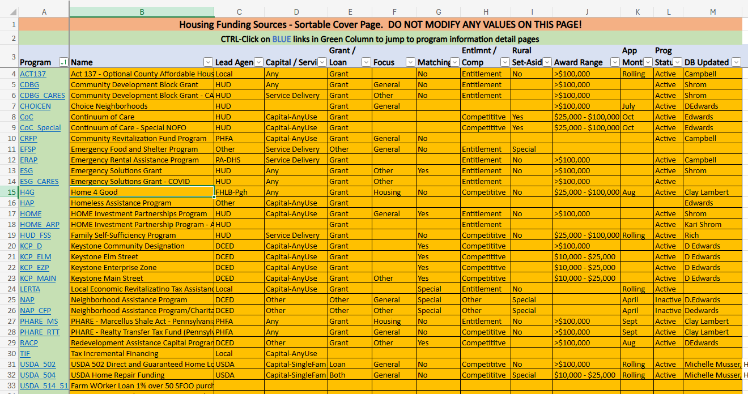
Lots of Funding sources

Slide 6
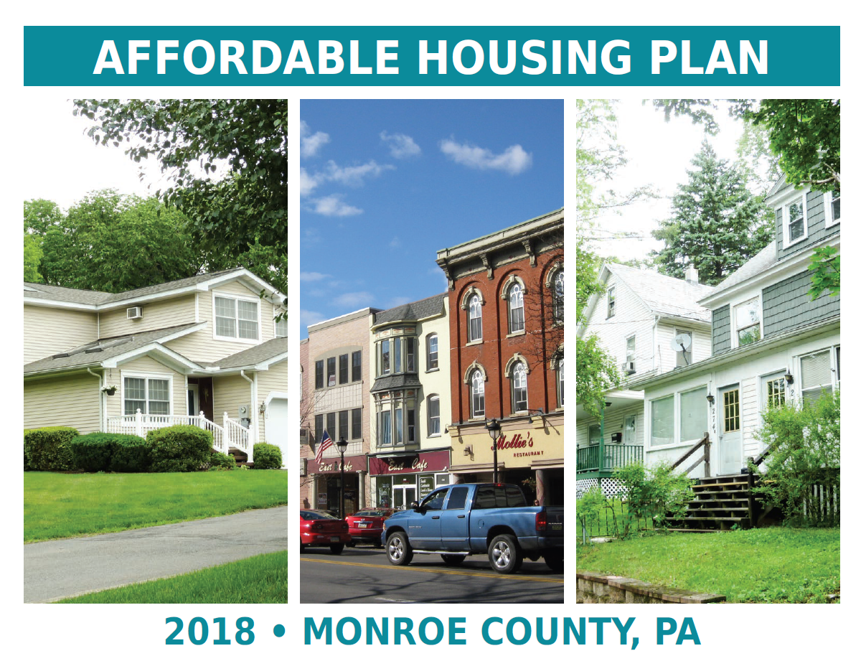

A Roadmap? Affordable Housing Plans

Slide 7
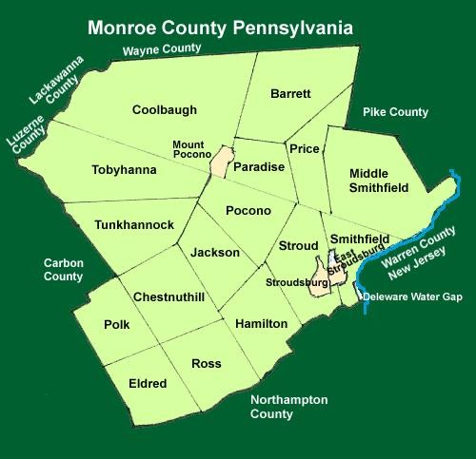
The Roadmap was:
I’ve built a great list of To-Dos
Now I just need to find someone to do them

Slide 8
Who’s going to make something happen?
Housing Authority
County Government Boroughs
Economic Development Authority
United Way Chamber of Commerce
County Planning Dept
Redevelopment Authority Housing Assist Agencies
Churches
Community Action Agency Community Dev Corp

Slide 9
Who’s going to make something happen?
Expectation
Housing Authority
County Government Boroughs
Economic Development Authority
United Way Chamber of Commerce
County Planning Dept
Redevelopment Authority Housing Assist Agencies
Churches
Community Action Agency Community Dev Corp

Slide 10
What’s it going to take to
make something happen?

Slide 11
Who Cares?
Housing Authority Homeless Aid Agencies
Schools
Emergency Services Healthcare Providers
Municipal Planners
Elected Officials Faith Organizations
Employers
Economic Dev Agencies Chamber of Commerce

Slide 12
Find your Champions
Housing Authority Homeless Aid Agencies
Schools
Emergency Services Healthcare Providers
Municipal Planners
Elected Officials Faith Organizations
Employers
Economic Dev Agencies Chamber of Commerce

Slide 13
The Roadmap was:
I’ve built a great list of To-Dos
Now I just need to find someone to do them

Slide 14
Who’s going to make something happen?
Expectation
Housing Authority
County Government Boroughs
Economic Development Authority
United Way Chamber of Commerce
County Planning Dept
Redevelopment Authority Housing Assist Agencies
Churches
Community Action Agency Community Dev Corp

Slide 15
Who’s going to make something happen?
Housing Authority
County Government Boroughs
Economic Development Authority
United Way Chamber of Commerce
County Planning Dept
Redevelopment Authority Housing Assist Agencies
Churches
Community Action Agency Community Dev Corp

Slide 16
Poconos - Primary Issues
No clearly defined, empowered organization to manage housing production activities across organizations:
Planning, advocating, organizing
Lack of non-commercial rental housing construction sponsorship capacity:
Capital-focused non-profit to sponsor construction efforts combining public and private funding

Slide 17
Community Development of the Poconos
Affordable housing for all ages and incomes:
Municipal Collaboration
Rental Housing Creation
Owner-Occupied Housing

Slide 18
Community Development of the Poconos
Affordable housing for all ages and incomes:
Municipal Collaboration
Create viable building locations by supporting infrastructure improvements
Water and Sewer
Update zoning and construction regulations to support smart housing development
Educate public to address NIMBYism
Create an atmosphere that supports housing while protecting the habitat, beauty, and quality of life in our Poconos communities

Slide 19
Community Development of the Poconos
Affordable housing for all ages and incomes:
Rental Housing
Increase the supply of affordable rental housing
Develop apartment complexes with regional LIHTC developers
Collaborative build / re-use development for niche service providers (Re-Entry, Veterans, etc)
Facilitate and build Affordable Missing Middle
Urban infill
Rural on-site water / septic

Slide 20
Community Development of the Poconos
Affordable housing for all ages and incomes:
Homeowner Housing
A penny saved is a penny earned
Retain existing housing by supporting existing government or non-profit organizations to repair existing homes
Habitat for Humanity
ReDevelopment Authority
Work with land banks to buy and return uninhabitable homes to habitability at an affordable cost
Implement Community Land Trust homeowner housing solutions

Slide 21
Community Development of the Poconos
Affordable housing for all ages and incomes:
Homeowner Housing
Senior Housing
Working Households Housing
Disability Housing
Judicial Re-Entry Entry Housing
Emergency Shelter Housing

Slide 22
CDPoconos – The Journey
Found Champions
Courted Community Allies
Interviewed nearby Community Housing Development Organizations
Allocated 25% to 50% FTE
Marketed to LIHTC Developers for new housing
Public Education – Officials and community
Launched Community Development Corporation
ReStart(ing) Housing Coalition

Slide 23
CDPoconos - Challenges
Operational Funding
Municipal planning
Courting developers / finding affordable buildable locations
Understanding funding sources enough to interest / counsel local developers
Combating NYMBYism
Maintaining Public interest / presence

Slide 24
A few Resources
PHFA Rental Housing Inventory (By County) https://phfa.org/renters/#:~:text=PHFA%20Rental%20Housing%20Inventory
PA Multi-Family Developers Council https://www.padeveloperscouncil.com/
More Front Doors Summit (Poconos) http://morefrontdoors.com/
Community Development of the Poconos (CDPI) https://www.CDPoconos.org
Housing Funding Database (Out of date) https://poconounitedway.org/HousingFundingDatabase

Slide 25
Contact Information:
Tom Campbell Tom@PoconoUnitedWay.org

Slide 26
Supporting notes for The Journey 1
Champions –
Pocono Mountains Visitors Bureau & Pocono Mountains United Way
Funding, introductions, validation, mental support.
Champions need to understand – this is a long-game endeavor. Expectations for monthly progress reports will be a constant source of frustration
Community Allies:
County commissioner, Chamber of Commerce president, homeless shelter director, business leaders
Every potential ally is also a potential boat anchor who will do everything possible to hold back your efforts
Don’t do what I did by pushing too hard at first and creating a few adversaries that require endless work to try to bring back to the table.
Ask for introductions, meet, listen, look for opportunities to change your own mind, not theirs.
Build Trust. Earn Allies.
Interview CHDOs-
Try to identify an existing local agency to pick up this baton and run with it.
Otherwise look North, S, E, W for an existing CHDO-capable organization with good management and a strong balance sheet to see if they might expand to your area.
Note: Typically remote orgs may be able to build bruildings, but unless they have a perm presence in your area, they won’t know the county commissioners and city councils well enough to advocate for infrastructure and a change of mindsets – or sell your community to regional LIHTC developers
(NOTE – if we had a strong local CAA or CHDO-capable organization, we would have taken a very different path)
Funding for ¼- ½ FTE –
Champion (from 1 above) needs to be able to financially support at least a 25% FTE,
OR, you find a financially self-sufficient individual (retired) with skills and community focus

Slide 27
Supporting notes for The Journey 2
Market to LIHTC developers - Find locations with water & sewer and court LIHTC apartment developers.
Use the PHFA Rental Housing Inventory for your county to find existing developers to expand their capacity. Cold Call them if necessary
PA Developers Council is another place to look for developers.
Use your local knowledge and network to sell your area as a place they want to invest in next – Clear the runway with supervisors and elected officials, introduce to Econ Dev Corp, etc.
Public Information – More Front Doors
Take the information from Housing Alliance and other advocacy groups to COG meetings, the PSATS and PA State Assoc of Bureaus meetings. Present and Network.
Meet with housing assistance and housing authority directors.
Build expertise and recognition. Become the organization or person everyone associates with housing in the community. Use that platform with urgent but positive messaging.
TV interviews whenever housing legislation in action, etc.
Create a CDO (only if no other existing local organization can be dependably expanded to fill this role)
Use your allies to fill the board (and help network for funding)
Use the CDO to get housing coalitions running as committees of the organization
location search,
municipal relations,
PR, etc

Slide 28
Supporting notes for Challenges:
Funding for operations –
Currently dependent on original champions
Eventually – Portion of Developers fees
County / Municipal budgets
Philanthropic Organizations
Municipal Planning –
Staying on top of housing plans in each municipality
Recognizing right moments to interject needs for water-sewer add-ons to proposed commercial projects
Address NO DEVELOPMENT mindset of some municipalities
Educating municipalities on zoning reform (and recommending resources for Tech Assistance)
Courting developers –
Funding sources unstable, limited will to commit
Falling back on self-funded mix-use developers
Understanding funding sources better
Local Developers want to utilize, however not enough expertise to guide them
Particularly difficult to figure ways to pursue missing middle with no home-grown talent (importing talent from Phila)
NIMBYism
Strong nature-preservation support in Poconos. Abuses by distribution centers have not helped the matter
Staying in the Public Eye
Running another summit like More Front Doors is very resource intensive – partnering with civic groups to do “Road Show” version in Pike and Carbon Counties

Slide 29
B6. Driving Rural Housing Solutions: Building Capacity, Coalitions, and Homes
Magnolia C/D – Dec 3rd 4:15 to 5:30
Bryce Maretzki - BMaretzki@phfa.org
Director of Strategic Planning and Policy
Pennsylvania Housing Finance Agency
Chad Martin - Chad@chestnuthousing.org
Executive Director
Chestnut Housing
Tom Campbell – TomC@CDPoconos.org
Director of Housing Initiatives
Pocono Mountains United Way & Community Development of the Poconos
2025

Slide 30


Slide 31

Chestnut Housing provides affordable rental housing to people experiencing homelessness because a home is the foundation of a healthy and fulfilling life. We connect people and communities of faith with tangible ways to create more affordable homes in Lancaster.

Slide 32


Over a decade-long track record
Operate 40+ apartments and homes
Dozens of households served

Slide 33
Turning Crisis Into Opportunity
Vision
Follow-through
Sweat Equity Matters
Quick to Partner, Slow to Hire
Nimble & Entreprenureal

Slide 34
Turning Crisis Into Opportunity
100 Homes in
Five Years

Slide 35
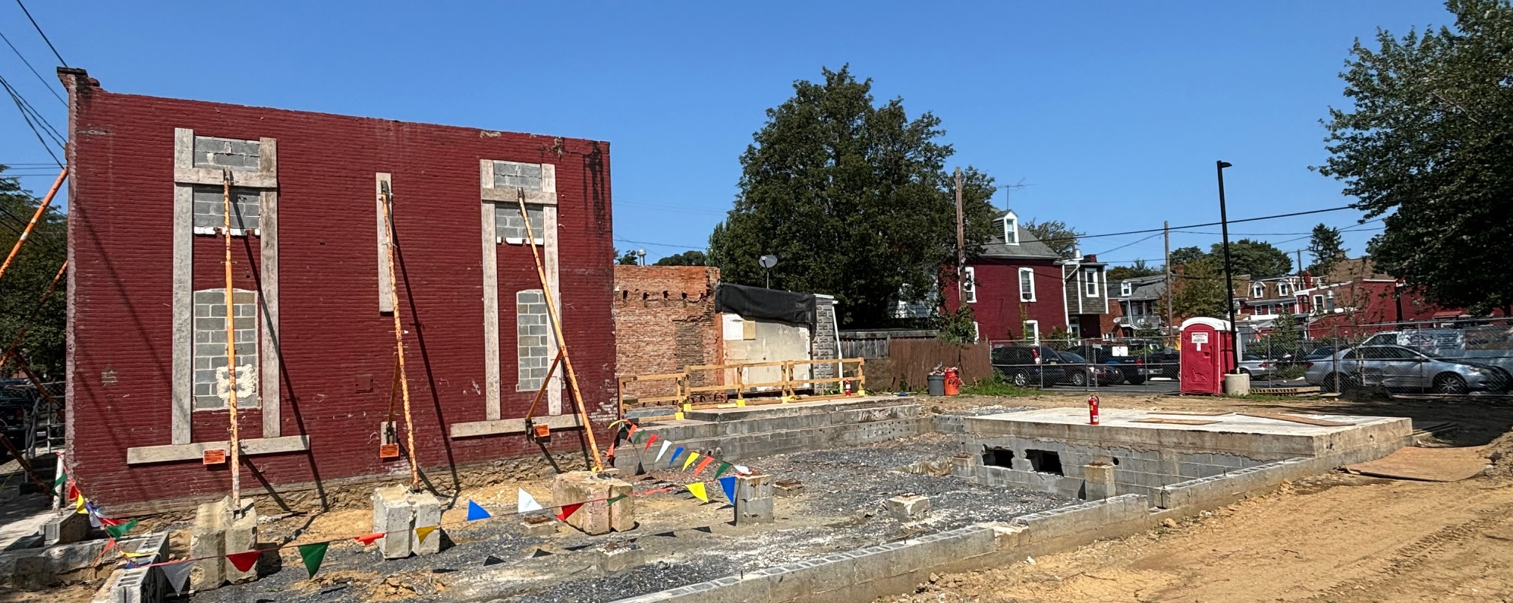


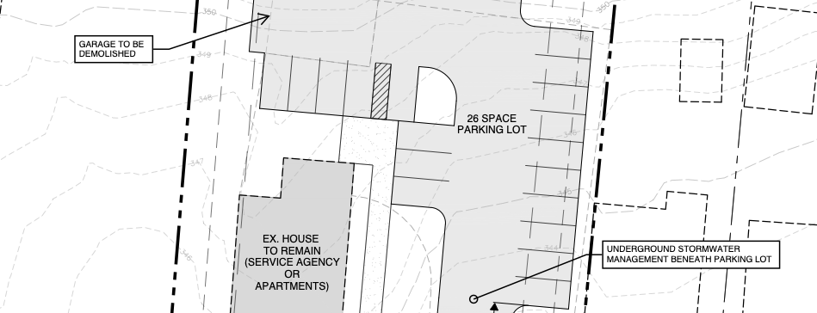
Milburn
Apartments
8 Apartments
Dinah’s Hill Apartments
11 Apartments + Offices
Bridgeport Housing
15 Apartments

Slide 36
Milburn Apartments
607 & 609 Rockland Street in Lancaster
Purchased from city’s redevelopment authority
Massive fire in 2020
Eight apartments: two 2-BR & six efficiencies
Income restricted to households below 50% AMI

Slide 37
Milburn Apartments
$2.2 Development Budget. Sources include:
City of Lancaster ARPA grant
HOME-ARP loan (LCHRA)
Local Shares Account Grant
ERAP 2 grant (LCHRA)
NAP-SPP – M&T Bank contributing
High Foundation
Loan from Lancaster County Community Foundation
Individual donations
Volunteer labor

Slide 38
Milburn Apartments
Over 1,000 hours of volunteer labor contributed to the project
100+ unique volunteers
Current savings to project budget = $25K to $50K
Completed in September and fully leased up!!

Slide 39
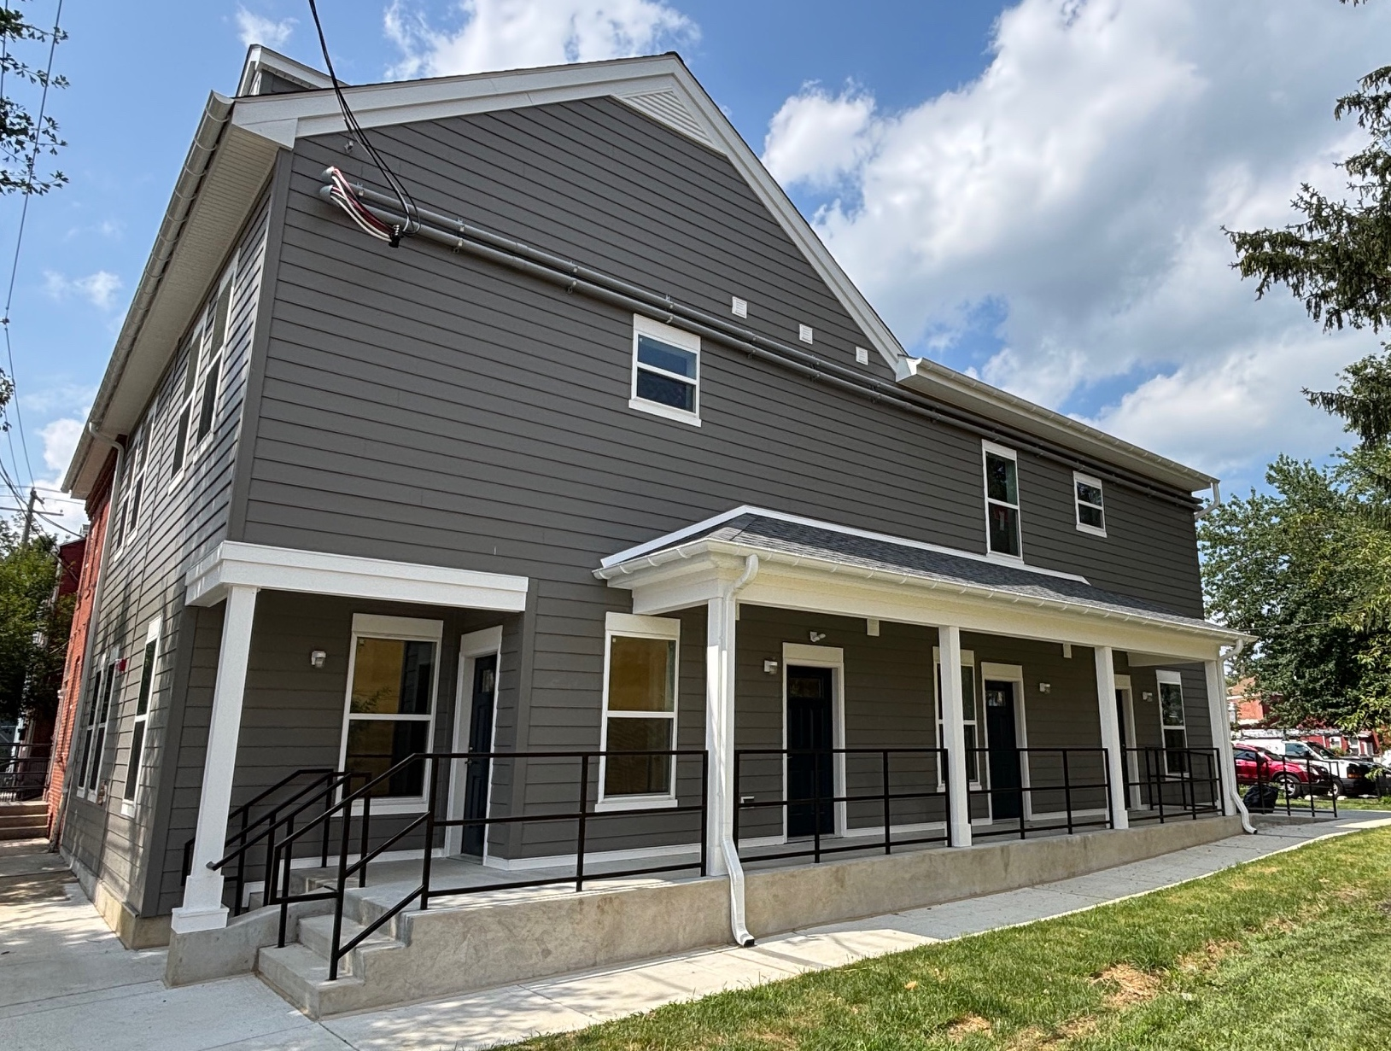
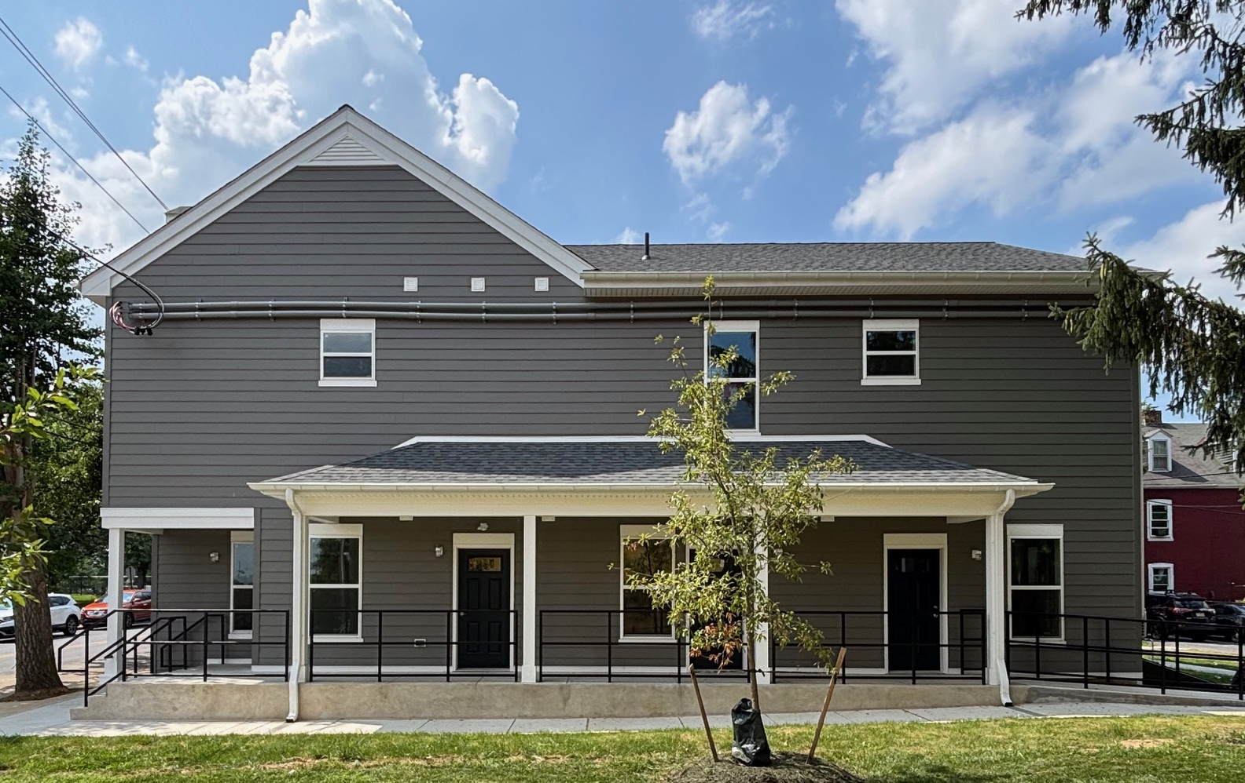
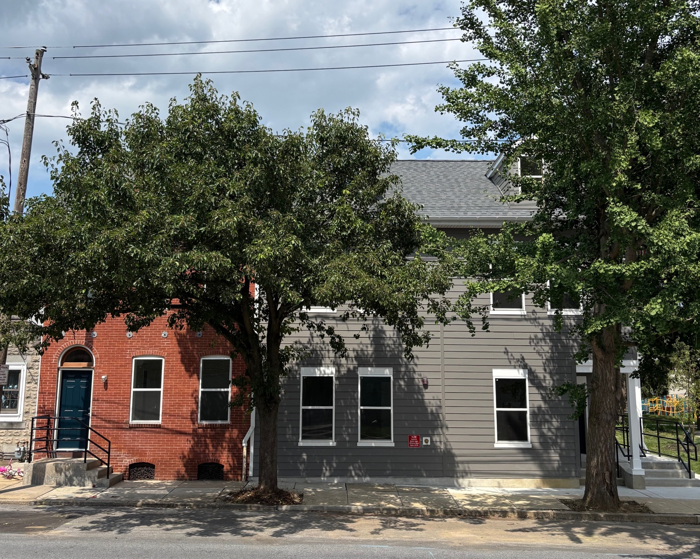

Slide 40

Dinah’s Hill Apartments
Historic restaurant site
11 new apartments
Offices and Meeting Space
$3.8 Million

Slide 41
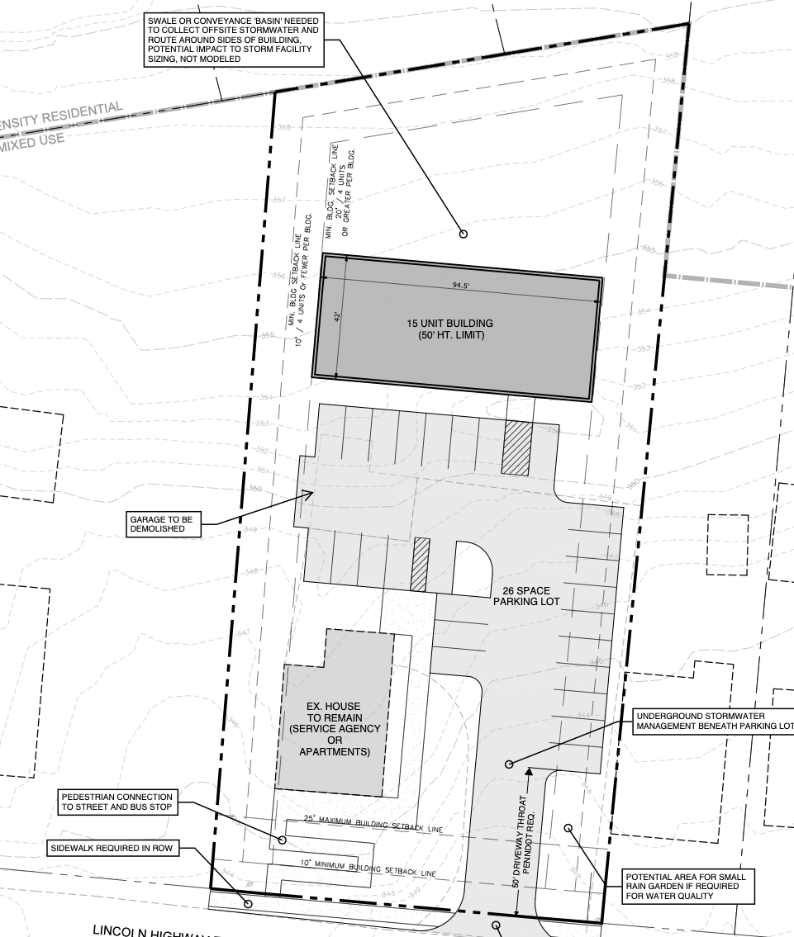
Bridgeport Housing
Partnership with members of Forest Hills Mennonite Church
Purchased in 2024; long term plans to develop 12-15 apartments.

Slide 42
Turning Crisis Into Opportunity
Vision
Follow-through
Sweat Equity Matters
Quick to Partner, Slow to Hire
Nimble & Entreprenureal

Slide 43
Education, Engagement & Advocacy
Building Housing Champions in Congregations
Creating Volunteer Engagement that Generates Investment
Strategic Leadership in Local Advocacy Initiatives

Slide 44
Board of Directors
Sue Waterfield
Cal Yoder
Nick Selch
Josh Carson
Ben Lesher
Lynn Bergey
Executive Director
Chad Martin
chad@chestnuthousing.org

Slide 45


Advancing Housing Choice in Lancaster County
Homeless Services Providers Network (HSPN) ~ July 21, 2025
Notes:
Thank you for the opportunity to join you today.I serve as the part-time Director for the Coalition for Sustainable HousingI am joined by XXXXXXWe are excited to share a quick overview of our coalition's work, strategic direction, and how we're engaging across sectors to address Lancaster County's housing needs.

Slide 46

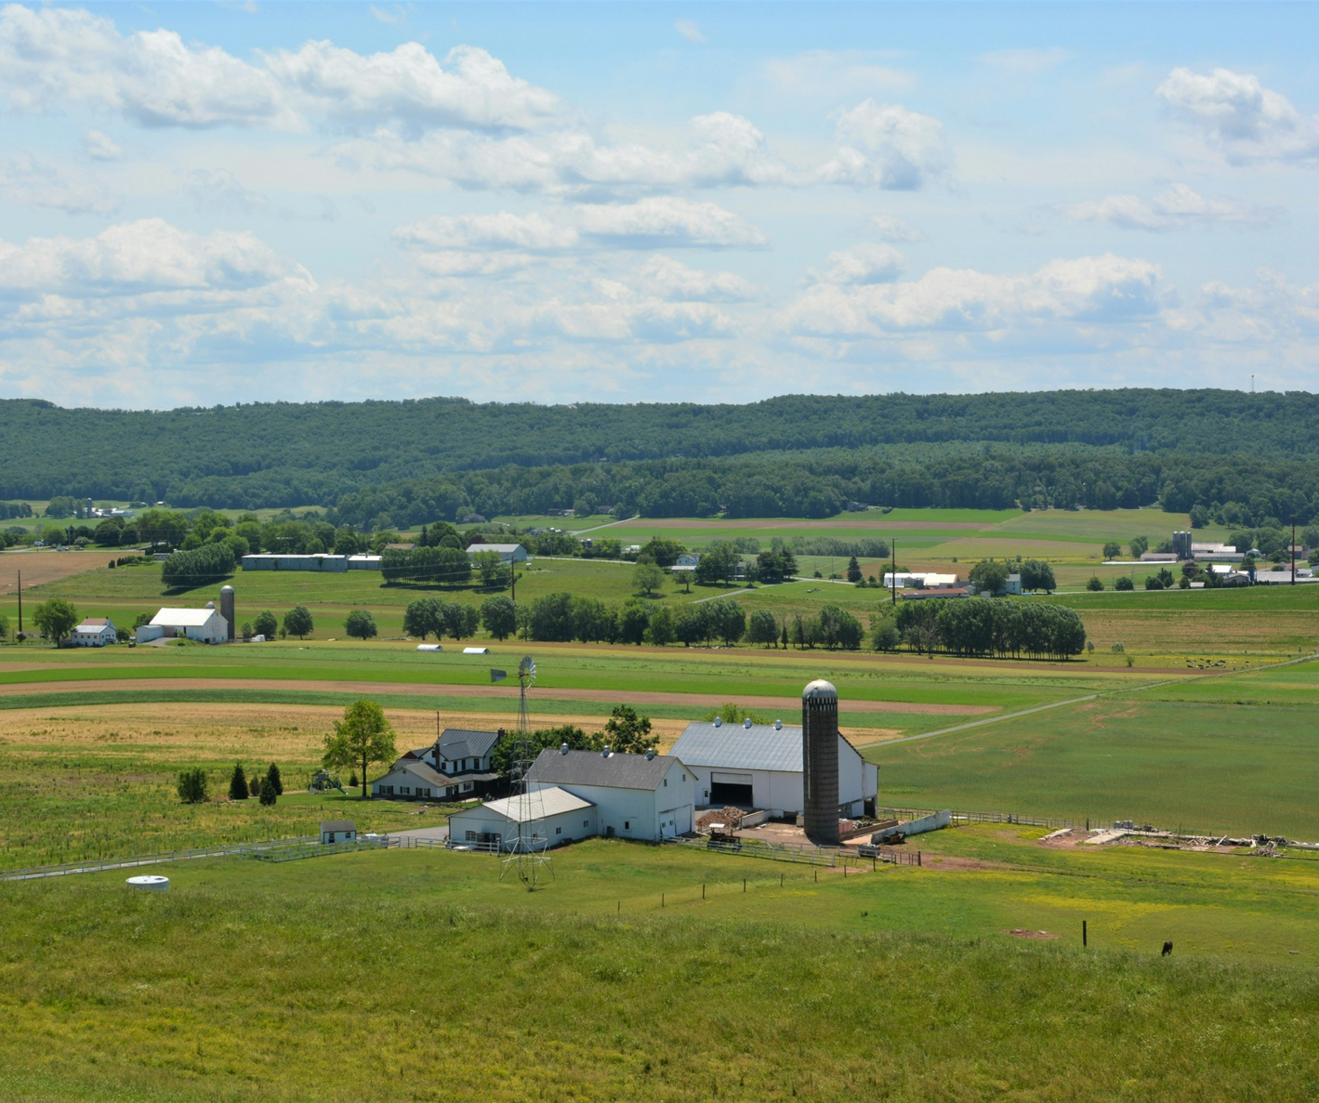
We bring together more than 145 members from across sectors: nonprofits, local governments, developers, advocates, residents
Our mission is to strengthen shared action on housing through zoning reform, public education, and aligned advocacy
C4SH is a countywide coalition focused on increasing housing access, affordability, and choice
Notes:
The Coalition is made up of over 145 individuals and organizations. We span sectors—nonprofit, private, public—and work across geographic and political lines. We share a belief that increasing housing options is not just a matter of policy, but a matter of economic vitality, community well-being, and long-term sustainability.

Slide 47
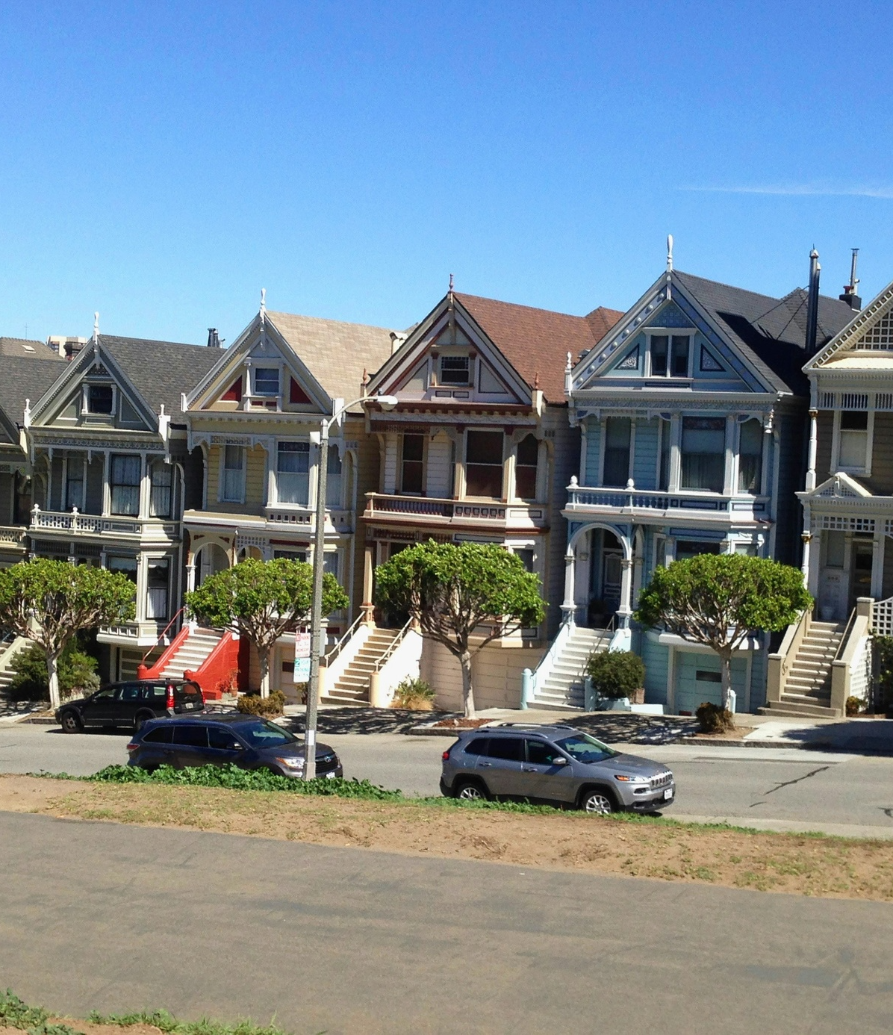
Current Focus Areas (Summer / Fall 2025)
Municipal Engagement: Continue meeting townships and boroughs to learn about their housing challenges and zoning practices
Strategic Planning: Finalize the coalition’s 18-month goals and quick wins
Policy Work: Supporting the policy working group and tracking state opportunities
Communications: Explore hiring a consultant to build a shared housing narrative
Notes:
This summer, I’m anchoring four main areas.
First, I’ve been meeting with township and borough leaders—some supportive, some just curious—to hear what they’re navigating and where there may be opportunities for zoning reform. We’ve had rich, place-based conversations in Warwick, Denver, Cocalico, and more.
Second, we’re finalizing our 18-month strategic framework and starting to implement early wins.
Third, I’m supporting the Policy Working Group as they track state-level housing legislation and coordinate with statewide coalitions. And finally, we’re preparing to hire a communications consultant to help us shape a stronger public-facing message on why housing—and zoning—matters.

Slide 48

Zoning Advocacy in Action
Zoning advocacy is a central focus of our work
In the next 6 months, we’re building a database of all 60 municipalities and tracking outcomes in 10 priority communities
We’re also developing an advocacy toolkit and launching a Housing Champions Pledge to support local advocacy
It’s about equipping people to show up where it matters with messages that resonate
Notes:
Our zoning work is not about pushing a one-size-fits-all solution. It’s about organizing people and information in ways that let us act strategically. We’re mapping out every municipality—who the decision-makers are, how engaged they’ve been, what kinds of zoning challenges they face.
From there, we’ll track outreach, follow meetings, and flag opportunities for collaboration. We’re also developing a toolkit—simple talking points, fact sheets, and FAQs—to help community members and allies speak up effectively.
And we’ll be launching a Housing Champions Pledge to make it easier for people to raise their hand and get involved at the local level.

Slide 49

Opportunities for Connection
Align housing access with workforce and economic stability
Connect local zoning issues to community and service provider insights
Invite businesses, advocates, and providers to share real-world barriers/successes
Build cross-sector support for housing champions and zoning reform
Explore opportunities to co-create messaging and amplify impact
Notes:
Provider Notes: We know that many of you in the provider community are working directly with people navigating housing insecurity—and that you see how zoning and local policy shape what’s possible. We want to better understand those connections from your perspective. Are there stories or patterns you’re seeing that we should be elevating in our advocacy? Are there gaps or barriers that could be addressed through local code changes or planning decisions? We’d love to find ways to reflect those insights back to municipal leaders.
Chamber Notes: We know that for many of you, workforce housing is not abstract—it’s deeply tied to your ability to recruit and retain employees. We’re interested in your perspective: What do you see as the most pressing housing barriers for working families in Lancaster County? Are there ways we could work together to make zoning conversations more accessible to the business community? Whether it’s sharing data, developing messaging, or coordinating visits with local officials, your insights and voice are welcome.

Slide 50
B6. Driving Rural Housing Solutions: Building Capacity, Coalitions, and Homes
Magnolia C/D – Dec 3rd 4:15 to 5:30
Bryce Maretzki - BMaretzki@phfa.org
Director of Strategic Planning and Policy
Pennsylvania Housing Finance Agency
Chad Martin - Chad@chestnuthousing.org
Executive Director
Chestnut Housing
Tom Campbell – TomC@CDPoconos.org
Director of Housing Initiatives
Pocono Mountains United Way & Community Development of the Poconos
2025

