Slide 1

From Crisis Response to Systems Change: Evolutions in Eviction Prevention
Wednesday, December 3, 2025
Homes Within Reach Conference
Notes:
Phyllis Introduction

Slide 2
Presenters
Abby Rae LaCombe, RentHelpPGH
Swain Uber, Community Justice Project
Reilly Force, Friends Association for Care and Protection of Children
Urias Cole, Friends Association for Care and Protection of Children
Moderator: Gale Schwartz, Housing Alliance of Pennsylvania
Notes:
Moderator welcome and level setting-
Why eviction prevention matters
What are key elements of high-performing holistic eviction prevention programs
Chester county
Provide overview of program
Highlight process and services for a program that is all housed within a single agency
Allegheny County
Provide an overview of the ecosystem
Highlight processes with focus on systems-level approaches, including government buy-in and partner engagement
Moderator transition to Q&A
Summarize where common elements within both models and what made the programs last when others have ended with pandemic resources
If time allows: Brief pitch on HAP works to support communities looking to create new or strengthen existing eviction prevention programs

Slide 3
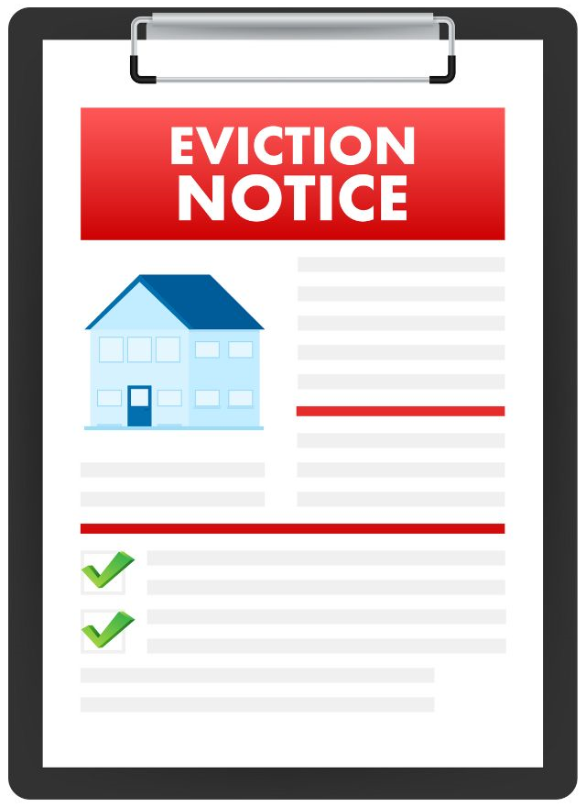
Why Does Eviction Prevention Matter?
Notes:
Gale
After presentation-What surprised from you
Share what is known about the causes of eviction with as much local context / data as possible
Lay out how eviction impacts different stakeholders and create shared goals for what eviction prevention will do in this community

Slide 4

What Is Working To
Prevent Evictions?
Notes:
Gale
What Can We Do About Eviction?
Everyone has a shared understanding of what the different components of a strong eviction prevention program are
Create a plan / specific understanding of how the group wants to improve eviction prevention in this community

Slide 5




Meeting the Needs of Landlord and Tenant
BALANCED
EVICTION PREVENTION
DIRECT ASSISTANCE
DISPUTE SETTLEMENT
RESOURCE
NAVIGATION
Facilitate communication/ negotiation
Housing and/or financial
stabilization
To cover past
due rent
Notes:
Gale
High-performing and holistic eviction prevention programs have three core components.
Each of these components can be and has been a stand-alone service available in many communities.
But we are seeing that when the services are packaged together and delivered intentionally and strategically at critical moments, we are seeing significantly better outcomes for both tenants and landlords
DA- ADDRESS THE UNMET BUSINESS NEED OF THE LANDLORD- Landlords need the rent
DS- WITH LANDLORD-TENANT MEDIATION AND/OR LEGAL REPRESENTATION
RN- TO PROMOTE STABLE TENANCY GOING FORWARD – to make sure people do not fall back into the same situation few months down the road

Slide 6


What Are The Types of Eviction Prevention Programs?
EXPANDED LEGAL ACCESS
LANDLORD TENANT MEDIATION
Notes:
Gale
Expanded Legal Access Programs or services that make it easier for tenants to get legal help in eviction cases, such as free lawyers, advice, or clear information about their rights.
A process where a neutral third person (the mediator) helps the landlord and tenant talk through their issues and try to reach an agreement. Mediation is voluntary, less formal than court, and the mediator does not make decisions—they help both sides find a solution they can both accept.

Slide 7



What are the Promising Practices & Strategies for Eviction Prevention?
CREATES CONNECTIONS
TO OTHER RESOURCE
EASILY ACCESSIBLE
FOR TENANTS
COLLABORATION
WITH THE COURTS
To connect tenants and landlords with helpful resources while keeping the court fair and neutral.
Intensive and proactive outreach to meet tenants where they are.
Offering help in the courthouse and making sure tenants get notified at every step
Notes:
Gale

Slide 8



What Does Success Look Like?
PRE-FILING
POST-FILING
POST-FILING
NO EVICTION FILING
Tenant and landlord have successfully come to an agreement and court is avoided all together
CASE WITHDRAWN
A landlord may withdraw the complaint at any time prior to the hearing by filing a written notice with the court
CASE SETTLED
The parties may file a notice of settlement of the complaint with the court at any time prior to the entry of judgement.

Slide 9

Friends Association for the Care and Protection of Children
Chester County, Pennsylvania
Urias Cole and Reilly Force

Slide 10
Mission, History, and Programs
Mission
Friends Association prevents homelessness by transforming lives, empowering families, and strengthening our community. We believe everyone deserves a home.
History
Founded in 1822 as an abolitionist Quaker movement
The first shelter opened in 1984
By 2010, our mission became focused on family homelessness and housing instability
Eviction Prevention Case Resolution program started in late 2020
Programs
Eviction Prevention Case Resolution (EPCR)
Family Center (Emergency Shelter)
Housing Stability Case Management (HSCM)

Slide 11
FY 2024 Statistics
291 households were served in Eviction Court
In almost 7 out of 10 cases, the outcome was favorable for the tenants
593 children were supported across programs
100% of families in the housing stability case management program transitioned to stable housing while in the program
100% of families were connected to benefits, resources, and improved money management while in the case management program

Slide 12




EPCR is a court-based program that provides a combination of
Legal Services Financial Assistance Internal Case Relocation Services
Management Referrals
Notes:
EPCR is a court-based program that provides the combination of limited legal, financial and social services to households facing imminent eviction.

Slide 13
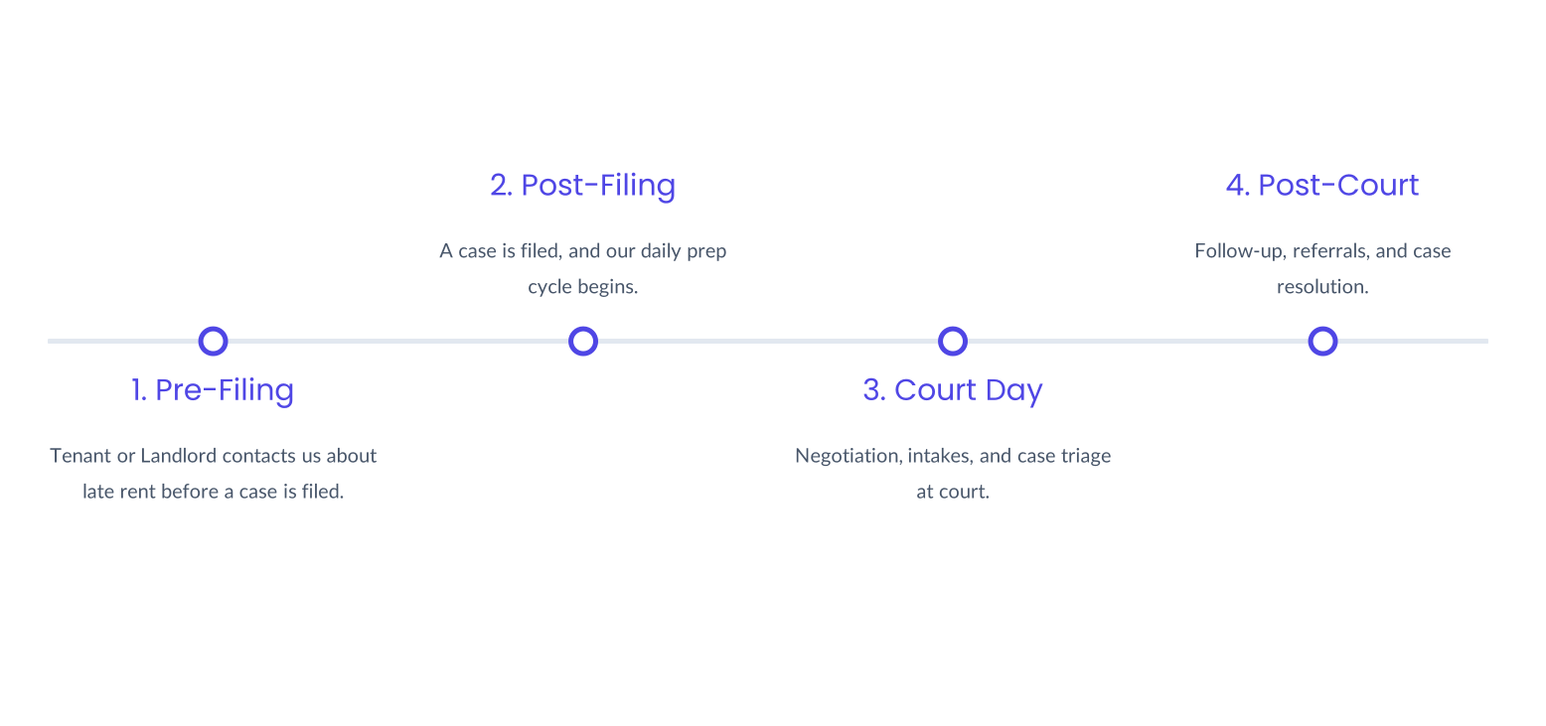
Timeline

Slide 14


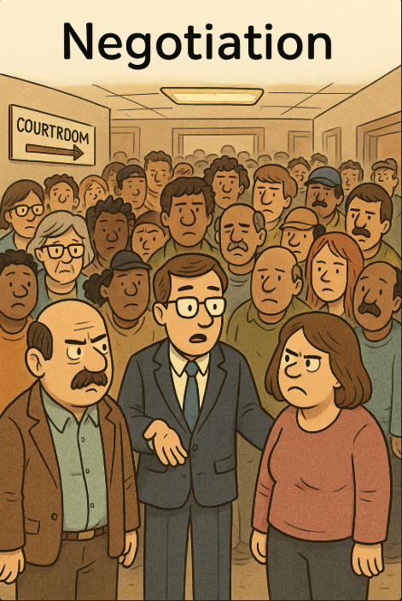


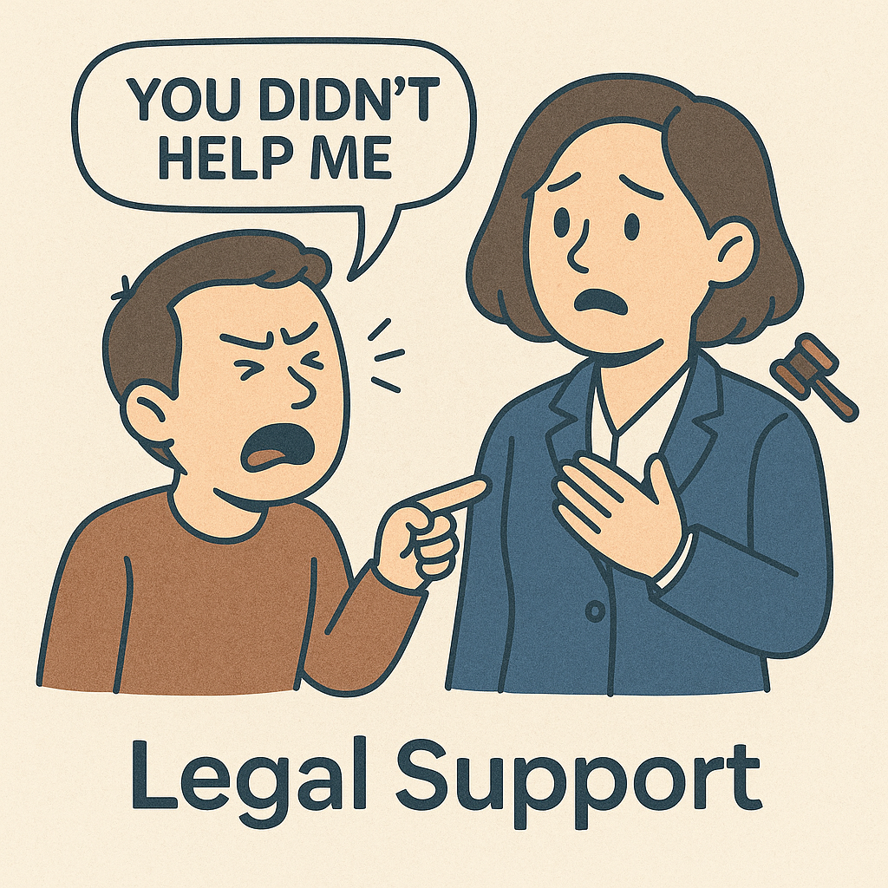

Day of Court
Negotiation
Intakes
We attend court cases and talk to both tenants and landlords to find resolutions.
We conduct intakes for tenants who need EPCR services right on the spot.
Legal Support
Team Wrap-Up
Lawyers provide legal services to tenants, which includes negotiating with landlords and other attorneys and if needed, defending tenants in courtroom.
At the end of the day, the team meets to break down the day's outcomes and triage cases.

Slide 15
What is the role of the Courts?
Unified scheduling, if possible
Multiple courts may have hearings on the same day and times
Cooperation
Landlord tenant (LLT) requests
Email continuance and withdraw requests
Patience
Negotiations
Changes in plans
Multiple continuance requests
Recognition
Positive community impact through reduced displacement
Measurable outcomes showing lower eviction rates

Slide 16
110 households were referred to internal Housing Stability Case Management program
Average time in the program: 9 months to 1 year
This year, Friends implements a new STEPS model for all case management
Housing Stability Case Management focuses on: *Relocation and housing *Budgeting *Connecting to resources *Employment security *Financial stability

Slide 17
What is Housing Stability?
Housing stability means having a safe, adequate, and affordable place to live without the immediate risk of losing it.
The household can pay rent/ mortgage and utilities regularly without fear of eviction.
The housing meets the family's needs for safety, space, and location. The family can remain in their current home if they choose to and can maintain housing without crisis-level interventions.

Slide 18
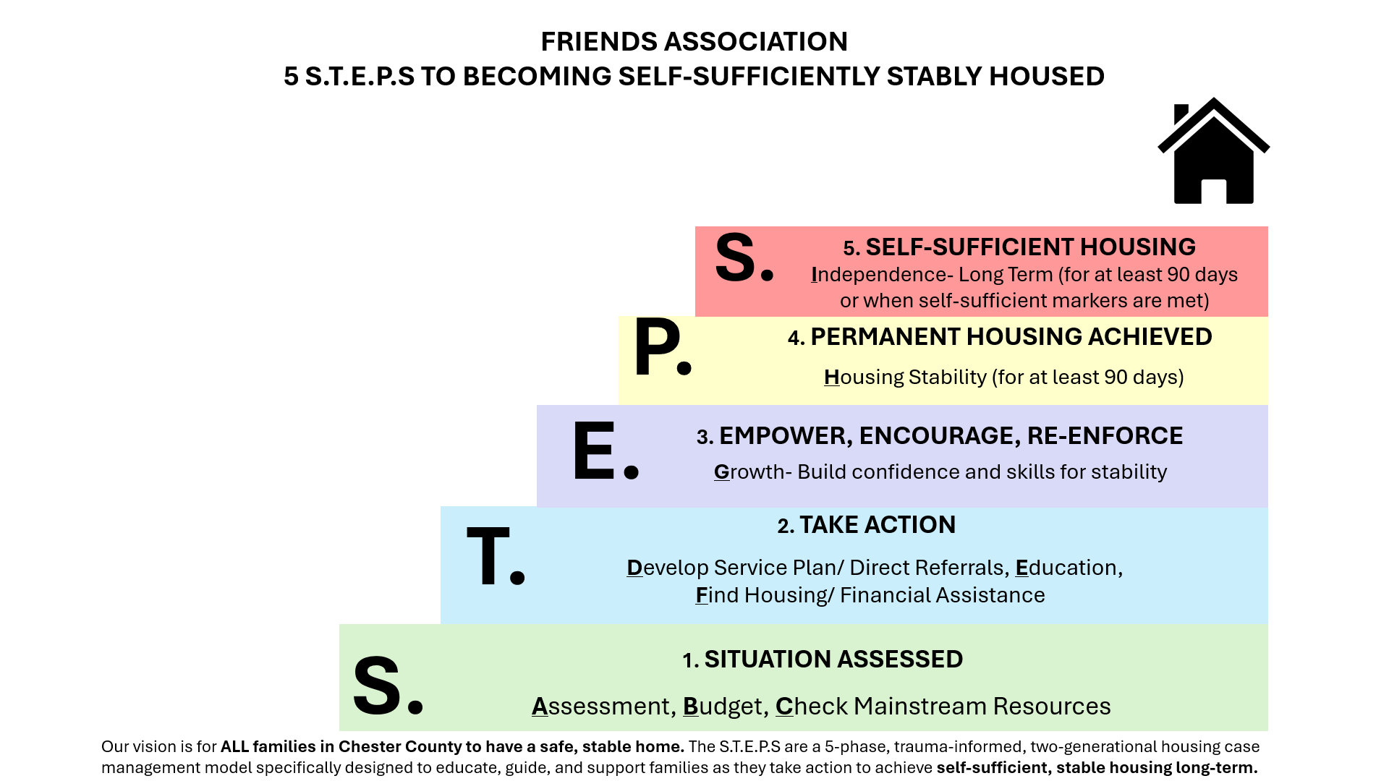

Slide 19

Applying Trauma-Informed Approaches and Two-Generation Approach
Build trust with consistency and clear expectations
Empower clients by offering choices and respecting autonomy
Use active listening and avoid re-traumatization
Recognize trauma's impact on behavior and stability
Address parent goals (benefits, income, employment, health, etc.)
Include child goals (childcare, clothing, therapeutic services, etc.)
Identify family routines and barriers impacting housing stability
Engage both generations in planning where appropriate

Slide 20

Post Pandemic Evolving Challenges
No more Emergency Rental Assistance Program (ERAP) funds
Program eligibility and resource restrictions
Rising rental cost and fewer affordable housing options
Increased household debt and financial instability
Longer or closed waitlists for subsidized housing and vouchers
More complex cases as families face multiple overlapping barriers

Slide 21

For more information,
please contact
Urias Cole, Director of EPCR
u.cole@friendsassoc.org
610-431-3598 ext 309
Reilly Force- Director of Programs
r.force@friendsassoc.org
610-431-3598 ext 206

Slide 22


Successful Eviction Prevention
in Allegheny County
Swain Uber,
Housing Attorney
Community Justice Project
Abby Rae LaCombe, Executive Director
RentHelpPGH

Slide 23
Eviction Overview
Notes:
Adam

Slide 24
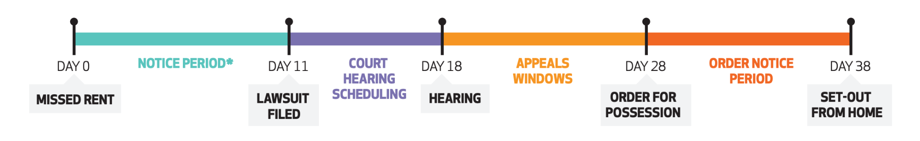
A Sequential Intercept Model for Eviction Prevention
Legal Helpline
Appeals
assistance
Mediation
‘Lawyer of the Day’
Rehousing Assistance
Housing Stabilization Center
Rental Assistance

Slide 25
Why Eviction Prevention Matters
The Eviction Crisis is here!
More than 14,200 eviction filed in 2024 and more than 1,500 mediations (one of the highest years on record!)
2025 is on track to see as many filings
The Infrastructure Already Exists to Address this Crisis!
In response to the COVID-19 pandemic, we built an effective, responsive infrastructure.
This infrastructure was costly and financed through one-time emergency funding from the federal government.
Eviction Prevention is Homelessness Prevention
1 in 3 unhoused people cite an eviction as a precipitating cause!
Preventing Evictions Saves Money:
A study of an eviction defense program in Philadelphia projected at least 12-to-1 return on investment, saving the city an estimated $45.2m each year and costing only $3.5m to implement.
Prevention costs 8-12x less than homelessness support and stabilization efforts: A person experiencing homelessness costs between $30,000 - $50,000 per year, while eviction prevention mediation costs an estimated $1,200 + rental assistance (average of $4,221/household).
Notes:
Chuck
2025 is on pace to match (Jan–Apr: 4,513 filings, nearly identical to 2024)
If all 15,700 actions had been eviction filings, this would have been the highest filing year in Allegheny County to date
Our average payment for rental assistance is $3,021 and the cost to rehouse an unhoused person $40,000.

Slide 26
Eviction Prevention Infrastructure
Rental assistance - ACTION-Housing, Inc. & the Allegheny Housing Stabilization Collaborative (AHSC)
Verifying and coordinating landlord-tenant information to address rental arrears and establish a fresh start for the housing relationship to continue.
Mediation - Just Mediation Pittsburgh
Bring landlords and tenants together to develop a mutually beneficial outcome to prevent the need for an eviction filing.
Legal assistance - Neighborhood Legal Services and Community Justice Project
Providing no-cost legal advice and/or representation for tenants at risk of eviction or experiencing housing instability.
Resource navigation & tenant outreach - RentHelpPGH and Pittsburgh Hispanic Development Corporation
Identify and help to access programs and services that can provide rental and utility assistance as well as longer-term household financial stabilization assistance
Notes:
Chuck
-Why resource navigation? What is it? Finding assistance was incredibly hard and the applications themselves are incredibly complicated. -Why tenant outreach? 10% of mailers bounced back due to bad addresses, ie at least 10% of tenants do not even know that they had an eviction filed against them. Additionally, people are often incorrectly evicted from addresses they no longer reside in. -None of this can happen without engaged landlords!

Slide 27
Rental Assistance as an Intervention Tool
Notes:
Chuck - what pieces are involved in making eviction prevention happen

Slide 28
How did we get here? What happens when there’s an emergency?
It took over a year—during a crisis—to build the rental assistance system we now rely on daily to keep families housed.
March 13, 2020: COVID-19 national emergency declared
Eviction moratorium issued due to lack of rental assistance infrastructure
The first rental assistance program didn’t launch until August 2020!
August to October 2020: only $400,000 disbursed.
Nov 2020 - Dec 2020: ACTION-Housing assumes administration, $13M disbursed
American Rescue Plan passed in January 2021
ARP funds built the entire assistance infrastructure - More than $500,000 to build!
March 15, 2021: ERAP launches
Months more to refine the system for the smooth operation we appreciate today
By 2025, this emergency-built system now serves thousands of households each year facing housing instability

Slide 29
Rental Assistance & Household Statistics
24,072 households have received a rental assistance payment in Allegheny County
9% of households have two or more adults with no children
43% are households with at least one household member being below 18
48% are households composed of a single adult
71% are households with a female head of household
Notes:
Nat
The Housing Stabilization Center in Downtown Pittsburgh serves an average of 400 people per month who come to access rental assistance, or receive resource referrals.

Slide 30
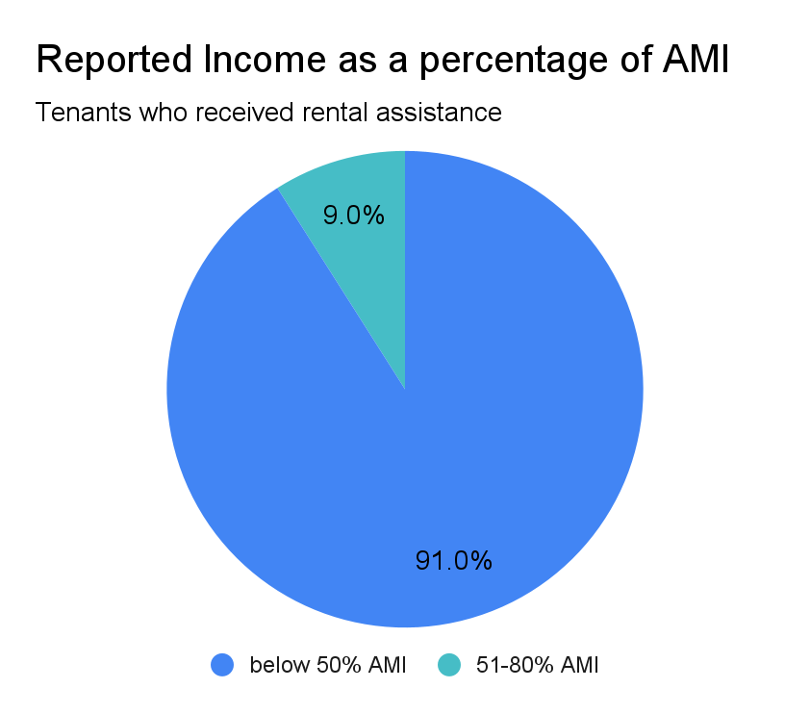
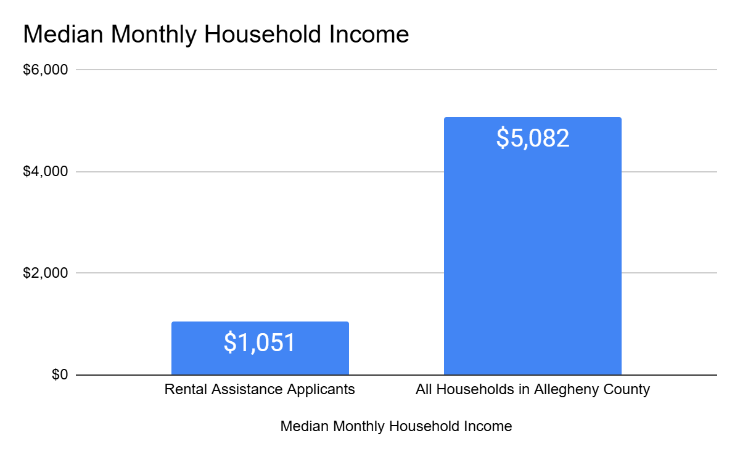
Household Income
Notes:
Nat

Slide 31
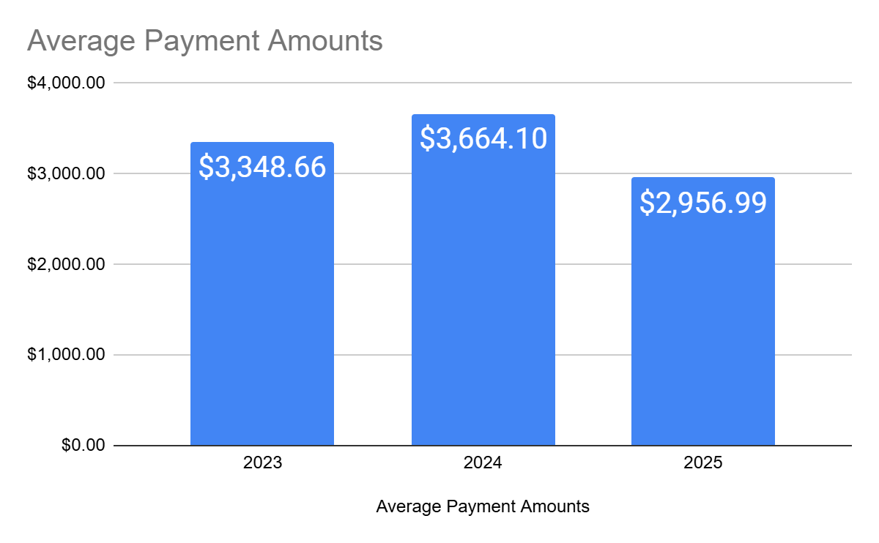
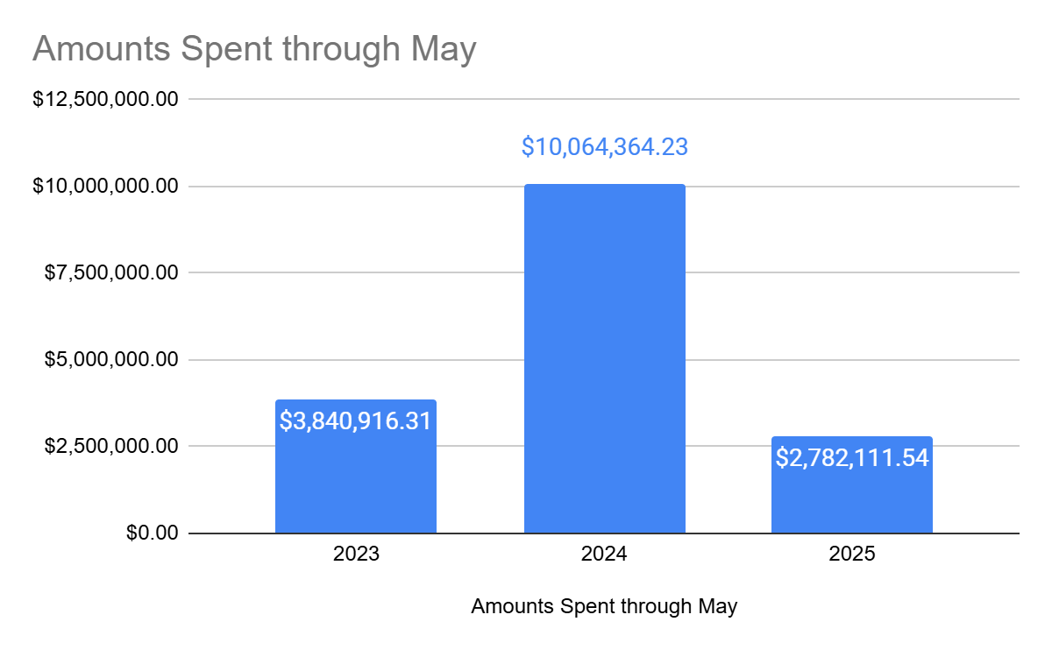
Average Payment
Amounts
Amounts Spent
Through May
Rental assistance proves effective for most recipients— 85% do not return for additional help.
Notes:
Nat

Slide 32
Number of Landlords Served by AHSC Infrastructure.
Since 1/1/24: 1,778
Since ERAP began on 3/15/21: 7,437
Top 5 most paid landlords:
Allegheny County Housing Authority
Riva Ridge Real Estate
Housing Authority of the City of Pittsburgh
Aegis Realty Partners
Arbors Management
Notes:
Nat

Slide 33
Entry Points: Mediation
Notes:
Mairead

Slide 34
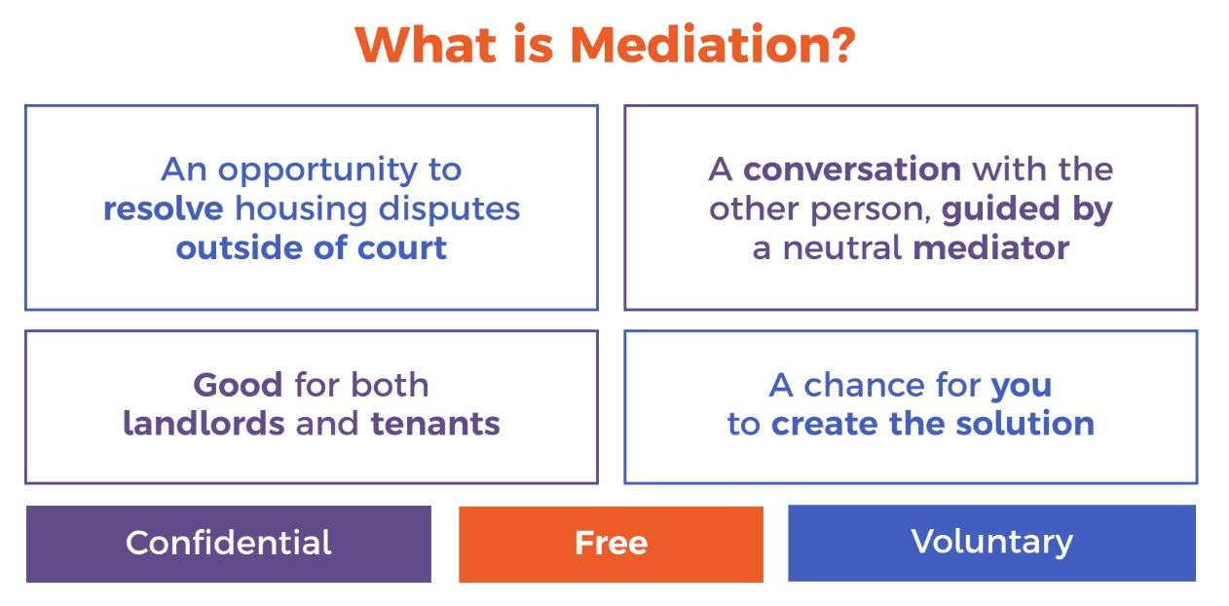
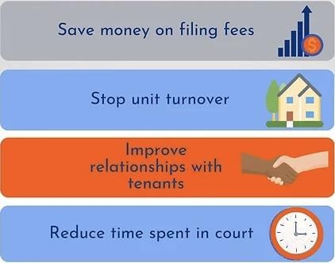

Landlord-Tenant Mediation
Notes:
Mairead
Mediation is the alternate to court, with the benefit that there would not be an eviction filing on the permanent record
Anecdote: diving below the surface to emphasize why mediated conversation increases understanding. Not just rental arrears - how did they get here??

Slide 35
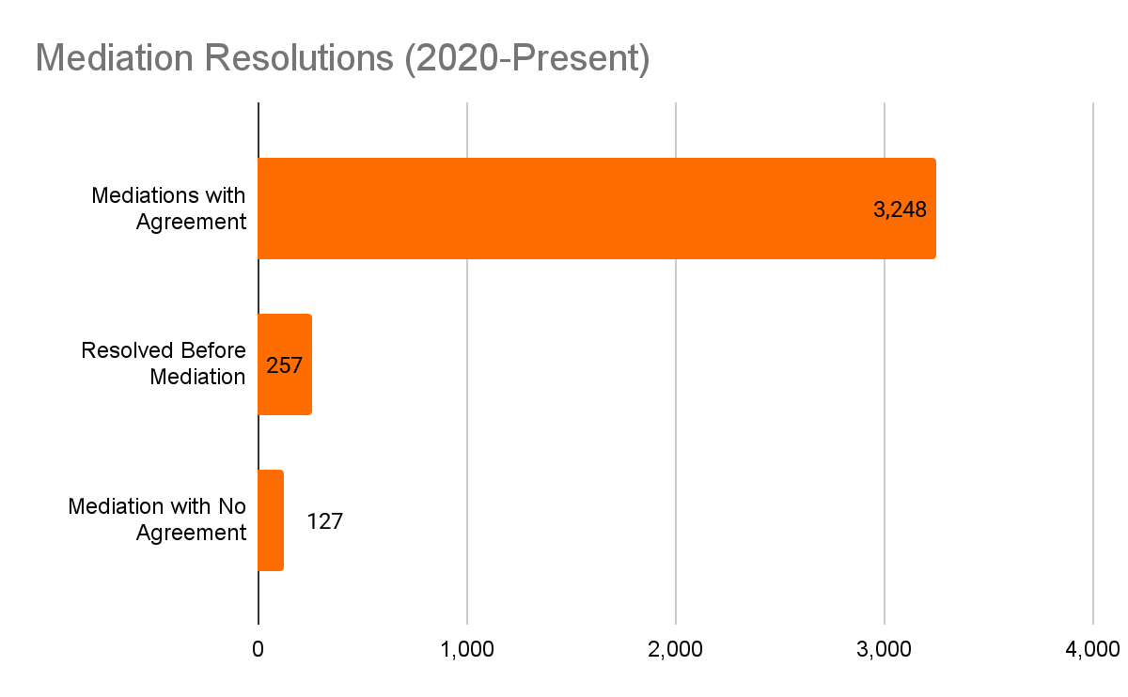
Landlord-Tenant Mediation Successes
3,505 resolutions reached since 2020
96.5% success rate when parties mediate
9,702 tenants and landlords served since 2020
Includes tenants, landlords, and property managers who have reached out to JMP and with whom JMP has made contact to schedule mediations or refer to services. No duplicative parties are included.
1,354 mediations held in 2024 (an increase of 19% from 2023)
Notes:
Mairead
Data is from 1/1/2020 - 5/23/25
Resolution = sometimes resolved before mediation!
Harken back to $5k avg cost / eviction = over $10M saved by LLs since mediation program launched, free for them plus $5M in arrears captured.

Slide 36
Mediation Testimonials
I am so grateful for everyone who helped me through this process. It’s easily been the most stressful thing I’ve gone through since becoming a single mom and I cannot express more how this has saved me mentally and financially. You’ve all set me up for success and I’m going to the moon now. <3
- Tenant
This is a wonderful alternative to going through the courts. There are many cases of people who fall behind on rent for many different reasons that are beyond their control, and this is incredibly helpful to for renters who are prepared to go forward, but need a clean slate to make a change sustainable.
- Landlord, mediated dozens of times
More than $4.37 million in rental arrears paid for by rental assistance
Notes:
$114,000 in rental assistance in march. $4,461,761.61 all time!
Marian Plaza example specifically. We got landlords on board!
Example from 5/15/25 - tenant who fell behind 2 months because of helping her son with attorney fees for a legal issue. Single mom, had started paying rent again, but couldn’t catch up.
Example from 5/20/25 - tenant who has a voucher, previously was living in an apartment with a black mold issue. Found new housing and moved in immediately, but couldn’t afford the security deposit/ last months rent. Started paying rent immediately, but accrued arrears bc of the LL’s system of applying payments to the oldest open charges. Able to receive rental assistance, and also come to an understanding of why she owed, and move forward stably.
Also similar situations where tenants move somewhere safe and sanitary but inspection doesnt take place for a couple months and they are charged market rate that they cant pay.

Slide 37
Entry Points: Court and Lawyer of the Day
Notes:
Adam

Slide 38
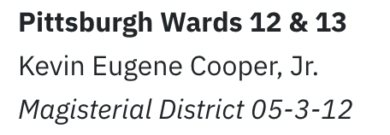
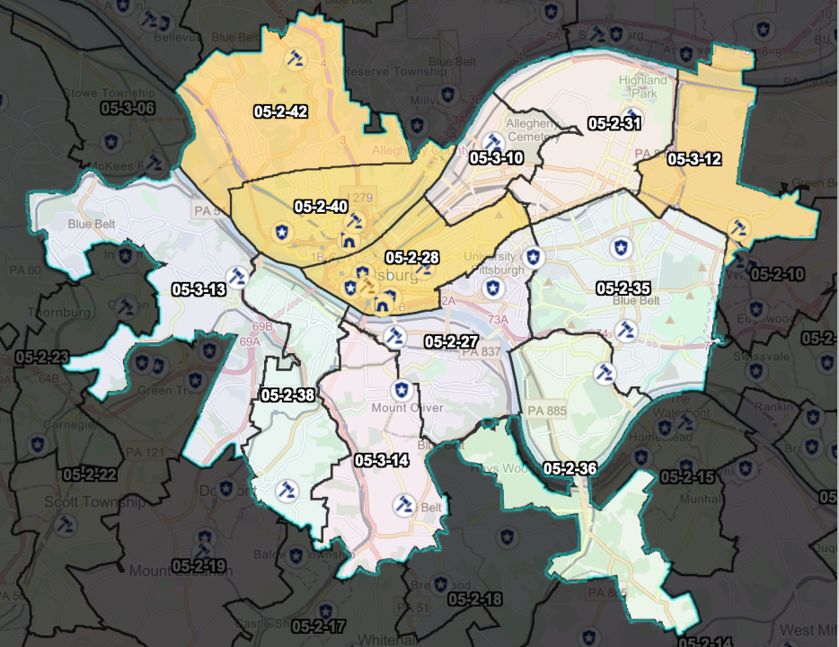
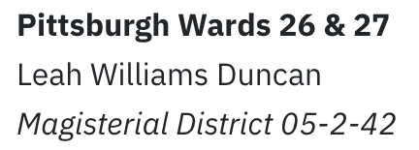

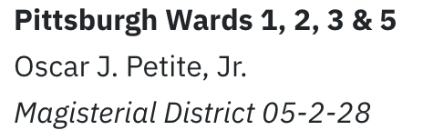
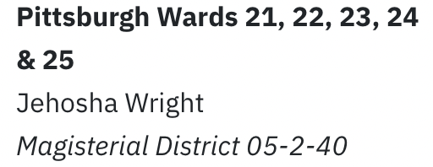
Lawyer of the Day (LOTD)
Present in 4 courts; ~41%* of all eviction filings in PGH.
*Based on 2019-2020 filing data
Notes:
Adam

Slide 39
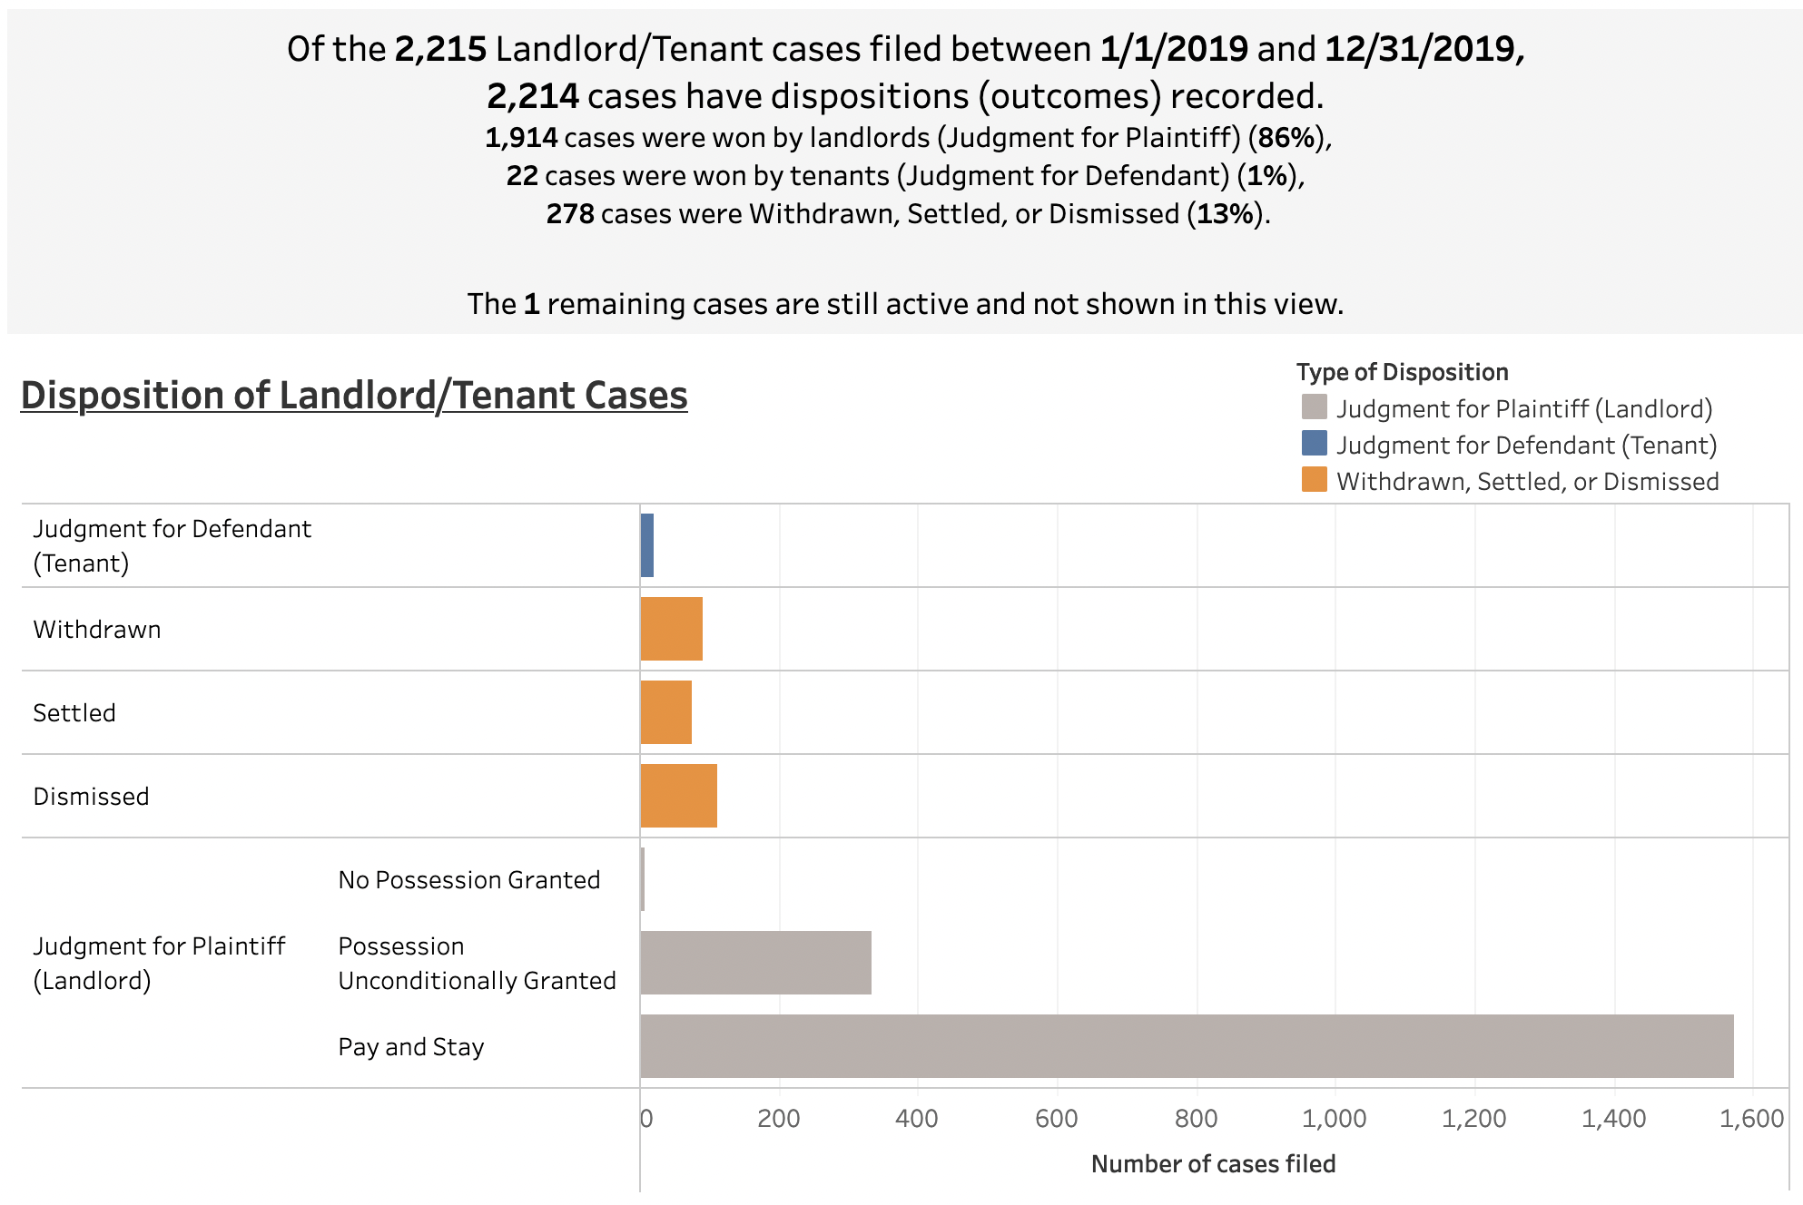
Pre-COVID Outcomes in LOTD Courts (Jan 2019-Dec 2019)

Slide 40
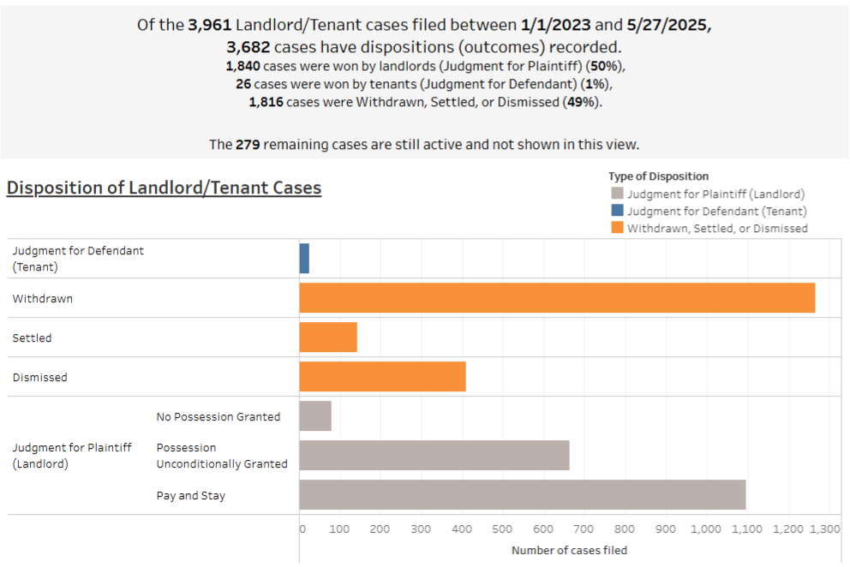
Outcomes in LOTD Courts since LOTD (Jan 2023-May 2025)
Notes:
This is up to date numbers!

Slide 41
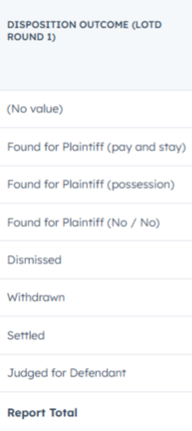
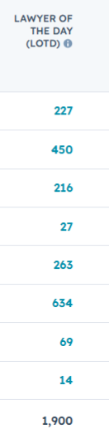
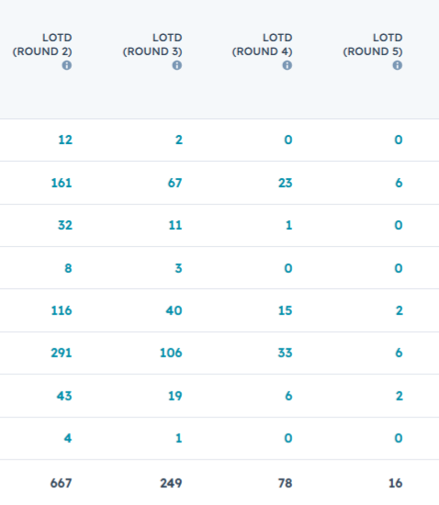
11/1/2022 - 5/27/2025
40% FFP rate vs ~85% historic rate; 67.5% of which can be remedied with rental assistance
60% positive outcome rate vs ~14% historic rate

Slide 42
LOTD Successes & Testimonials
400% increase in the positive outcome rate over the historic rate!
Everyone was respectful I never felt judged which is why it took so long for me to seek assistance out of fear of being judged. Everyone was efficient and always willing to help when needed. - Tenant
60% positive outcome rate vs. ~14% historic rate
Great program, equally beneficial to both tenant and landlord. - Landlord
Additionally, 67.5% of those that are judged against can have their judgment remedied with rental assistance!
More than $3.9M in rental arrears paid for by rental assistance

Slide 43
Landlord Successes
Notes:
Chuck - what pieces are involved in making eviction prevention happen

Slide 44
Landlord Experience
Mutual Benefit - Residents are served with safe, decent uninterrupted housing. Landlords received revenue to meet their ongoing obligations.
Cost Savings - Reduced expense of court time, spending on legal and uncertain court outcomes.
Protect our residents - Court diversion prevents collection actions from stigmatizing residents
Personal Insight: Participation in CARES, ERAP, and rental assistance programs has ensured timely rent payments, enhancing financial stability for my properties.
393 resident families at properties managed by Brandywine Communities have received rental assistance through ERAP and AHSC.
Brandywine has participated in hundreds of mediations with residents through JMP.
Notes:
John
Evicting a tenant costs a landlord, on average $5,000 per eviction
Our programs have provided more than 5 million dollars to make landlords financially whole

Slide 45
Building and Sustaining
an Ecosystem
Notes:
Chuck - what pieces are involved in making eviction prevention happen

Slide 46



Collaboration is Key

Slide 47
Philanthropic Leadership
You need a champion!
Jane Downing, formerly of The Pittsburgh Foundation (TPF)
Maintain consistency and deepen the collaboration!
Weekly and then biweekly meetings involving service providers, advocates, governmental officials, court administration, and community organization.
Continue the commitment!
TPF has made the “Housing Stability” a core strategic focus for its giving and programming.

Slide 48
Local Governmental Support
City of Pittsburgh’s Affordable Housing Trust Fund
Founding of the Housing Opportunity Fund
Creation of the Legal Assistance Program for Tenants
Launching of the Lawyer of the Day Program
Allegheny County’s Direct Investment in Programming
Department of Human Services support and collaboration
Council and Executive support based on results and models proven at the city-level

Slide 49
Contact Information
Abby Rae LaCombe
Executive Director abbyrae@renthelppgh.org
Swain Uber
Housing Policy Attorney
suber@cjplaw.org

Slide 50
incubator noun in·​cu·​ba·​tor ˈiŋ-kyə-ˌbā-tər
Definition:
An incubator is a structured, time-limited workshop designed to nurture new ideas into actionable strategies.
It brings together cross-sector partners to co-create solutions, test models, and lay the groundwork for implementation.
Notes:
The incubator incorporates a mix of information sharing, facilitated discussion, and interactive training tools. Attendees will develop a shared understanding of the root causes of eviction, the local eviction landscape, how the eviction crisis impacts different stakeholders as well as promising practices and program models. The day will finish with attendees crafting shared goals and identifying actionable next steps.
What is the goal of the initiative is:
Raising eviction prevention as a priority in targeted locations
Helping to create new partnerships and collaborations where there was not one

Slide 51
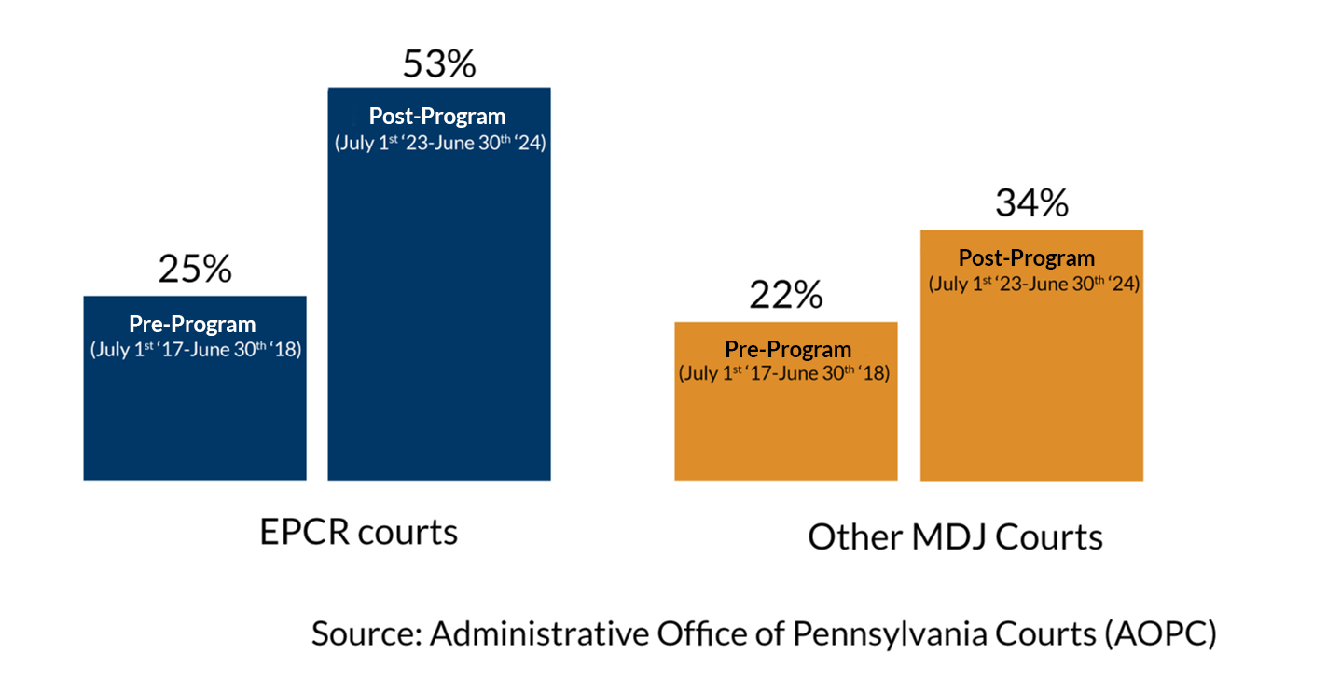
91% of families were able to STAY in their current home
Eviction Prevention
Case Resolution,
Chester County
Notes:
364 Households served in 2024
1023 Individuals
465 Children
Pre-program time period is July 1, 2017 – June 30, 2018. Post pandemic time period is July 1, 2023 - June 30, 2024. (https://friendsassoc.org/annual-report-2023-2024/)
Operates in 3 courts
Friends has hired a staff attorney and also has court coordinators
Friends staff is regularly checking public record of filings in service areas and conducting intensive outreach to tenants that have recently been filed on.
Once contact has been made with the tenant and an intake has been completed the staff attorney will reach out to the landlord and begin negotiating with them to find a settlement while resource navigator work to get tenant rental assistance and other needed resources.
Initial funding through United Way but also has accessed PHARE and ARPA as well as leveraged ERAP
Many times, case are continued and the tenants themselves do not need to attend the hearing because the attorney is there to represent them

Slide 52
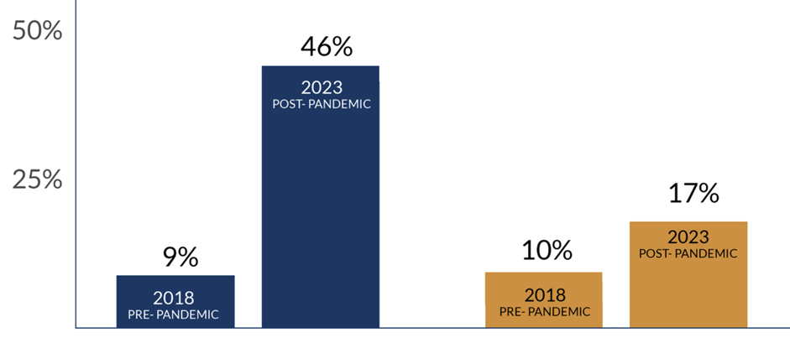
Positive Resolutions INCREASED NEARLY 5x from less than 12% TO OVER 75%
Eviction Prevention
Collaborative,
Allegheny County
LOTD Courts Case Withdrawals/Settlements | Other Magisterial District Courts Case Withdrawals/Settlements
Notes:
The LOTD program began in fall of 22, having expanded to 4 high volume courts in the City of Pittsburgh. The collaborating Magisterial District Judges arrange the schedules to ensure landlord tenant cases are heard on the same day.
Prior to the implementation of the LOTD program, only 9% of cases were withdrawn or settled in LOTD courts. However, recent data indicates a significant shift, with nearly 46% of eviction cases being withdrawn or settled in LOTD courts. In contrast, other magisterial district courts have not experienced such a substantial change in withdrawal and settlement rates (+7%).

